Slide 1
SREERAM ENGINEERING WORKS
Company Profile
Address:
183-C, Athipalayam Road,
Near GKD Matriculation School,
Periyanaickenpalayam,
Coimbatore-641020.
Ph. No : 97152-16494 ; 98657-16494
Email Id : mktg@sreeramengg.co.in
Website : www.sreeramengg.co.in

Slide 2
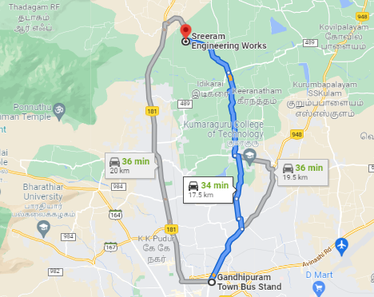
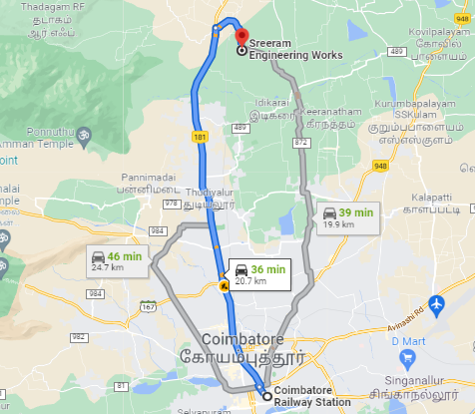
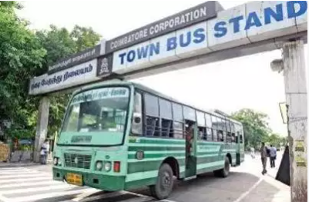
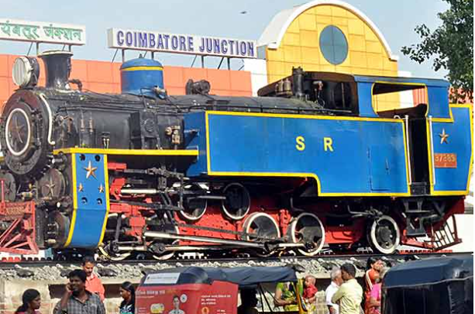
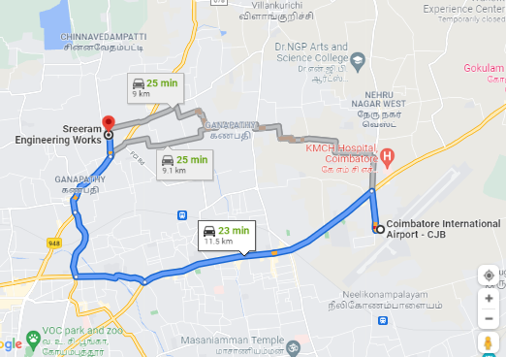
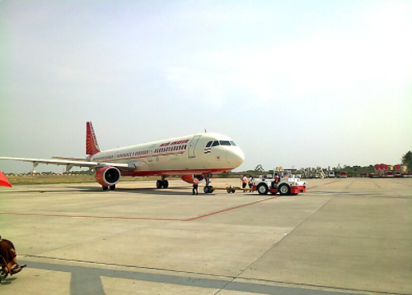
OUR COMPANY LOCATION
Google Map Location
https://goo.gl/maps/3PbgZjT8KdZVNBPGA

Slide 3


OUR VISION & MISSION
OUR VISION
To be among the top three OEM suppliers for all customers in
the casting / machining vertical
To be a class innovative progressive and India's desirable company
OUR MISSION
Through our commitment to quality and innovation aim to exceed expectation
We will meet our challenging goals by our talent, experience and new technology
Maintaining customer view point
Strive constantly for a harmonious flow of work
Process always with ambition and goal

Slide 4

OUR QUALITY POLICY
OUR QUALITY POLICY
Sreeram Engineering works is Committed for “Total Customer Satisfaction” Through Continual Improvement in its Products, Process & System

Slide 5

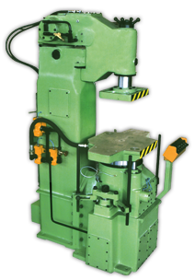

INTRODUCTION- Foundry
ISO 9001:2015 Certified Company
Manufacturer of all grades of SG & Grey Iron Castings
ARPA Molding- casting weight range 1 to 50 Kgs
ERP under implementation

Slide 6
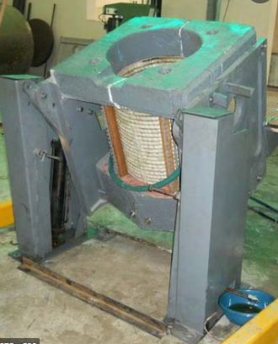
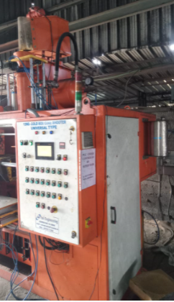
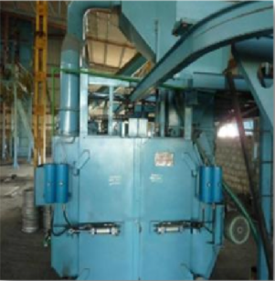
PRODUCTION FACILITIES - FOUNDRY
ARPA 300 Molding machine 1 pair with box size of 520x520x200mm & fully automated sand plant with PLC control.
1 ton capacity Inductotherm Furnace – 1 No.
500 kg capacity Inductotherm Furnace - 1 No.
500 Kg hanger type Shot blast machine
Core shooter –Cold Box (2 Nos.)

Slide 7
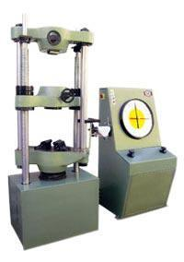
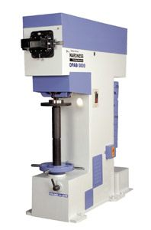
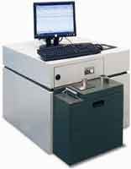
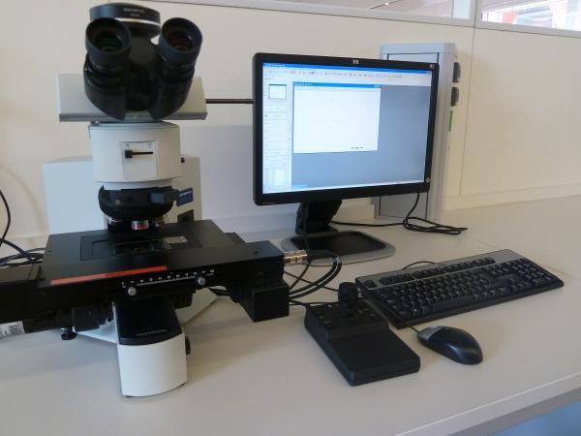
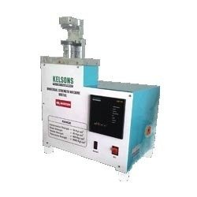
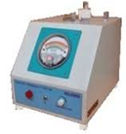
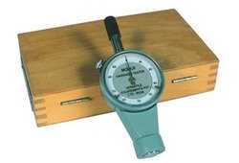
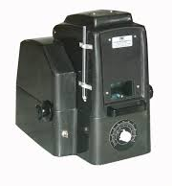

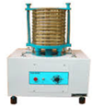

INSPECTION FACILITIES - FOUNDRY
UTM – FSA 600KN
Hardness Tester - BHN Meter OPAB
Metavis 108 N+ 25 element spectrometer
`
Sand testing Facilities
Infrared moisture Tester
Sand Rammer
Permeability Meter
Green Compression Strength machine
Sieve Shaker
Clay washer
Muffle Furnace
Mould Hardness tester
Image Analyzer – Metavis software

Slide 8
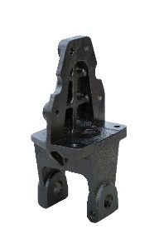
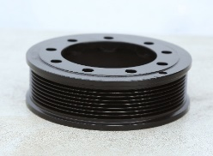
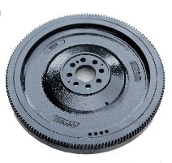
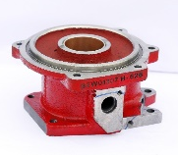
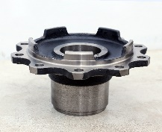
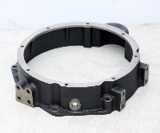
INTRODUCTION – Machine Shop
ISO 9001:2015 Certified Company
Specialist in machining of Hubs, Flywheels, Flywheel housings, Brackets & Pulleys
ERP Monitoring system

Slide 9
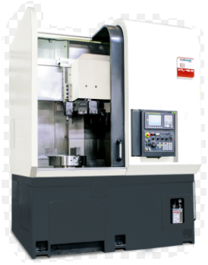
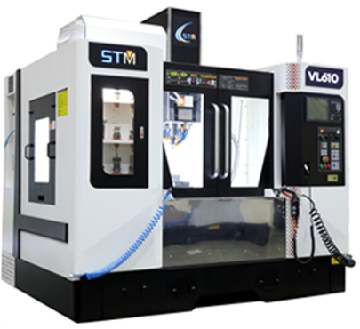
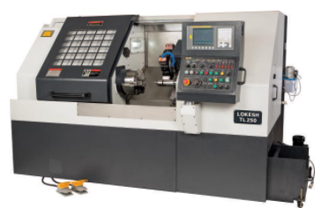
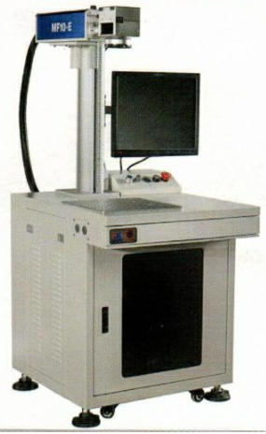
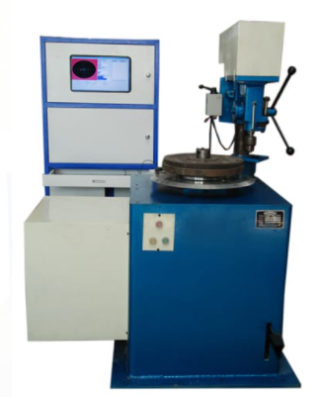
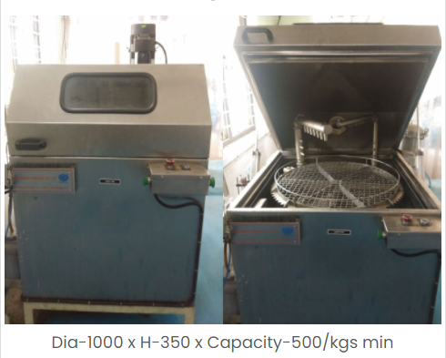
MACHINING FACILITIES
Vertical Machining Centers: 23 nos.
CNC: 9nos.
VTL: 4nos
With 4th axis attachment – 9 Nos.
With Indexing head – 7 Nos.
With Double pallets attachments – 6 Nos.
With single bed Operation – 1 No.
Industrial Washing Machine
Laser Marking Machine
Balancing Machine-2 Nos.

Slide 10
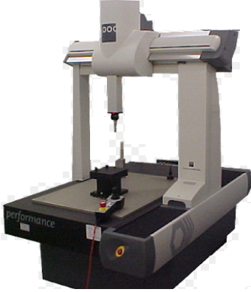
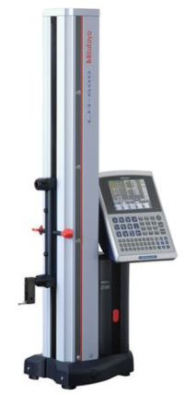
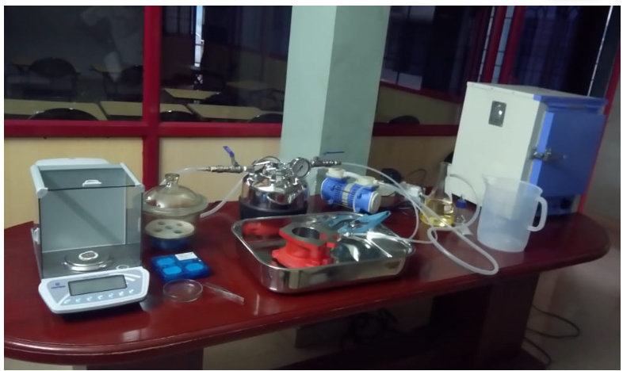
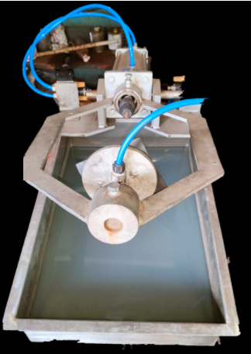
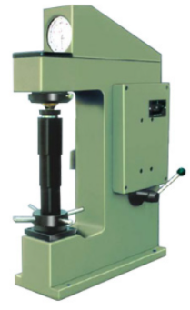
INSPECTION FACILITIES
CMM Brown & Sharpe Global series Size 1500 x 900 x 800mm
2D-Height Gauge (Range: 0-600 mm)
TESTING FACILITIES
Millipore Testing Arrangement
Leak Testing Arrangement
Hardness Tester

Slide 11
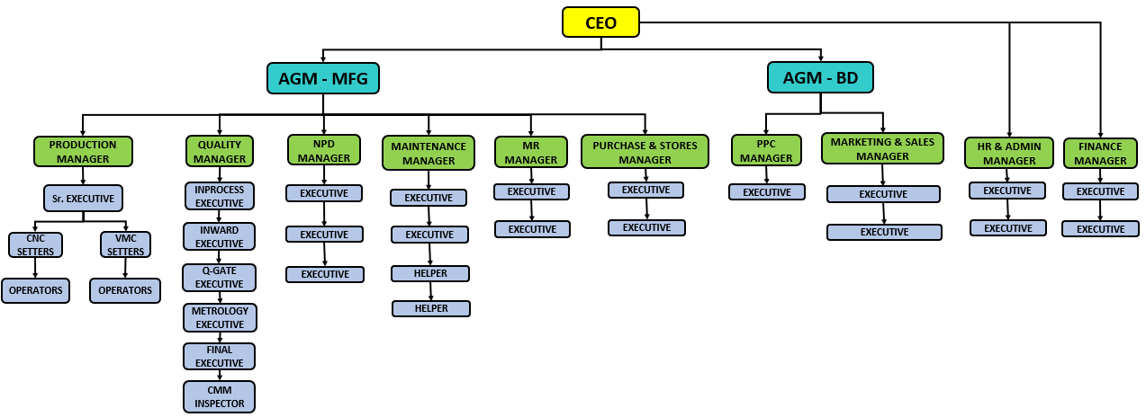
ORGANIZATION CHART

Slide 12
PROCESS FLOW CHART-NPD
Receipt of RFQ
RFQ Register
Feasibility Study
If OK
If Not ok
Quotation sharing to customer
Mail Comunication to Customer
PO receipt
Technical sign-off with Customer
Tming Plan Preparation
Development
Sample Submission

Slide 13
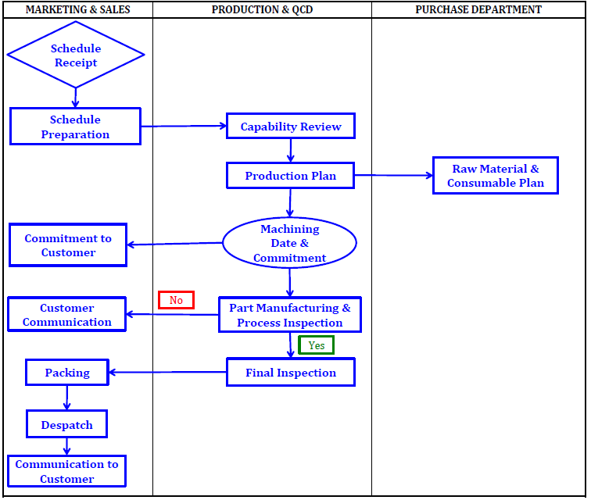
PROCESS FLOW CHART- REGULAR PARTS

Slide 14
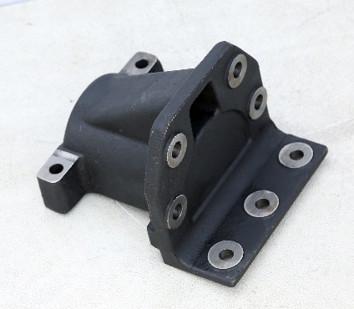

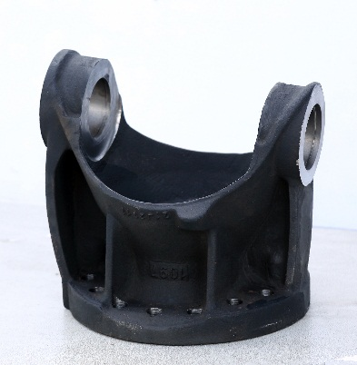
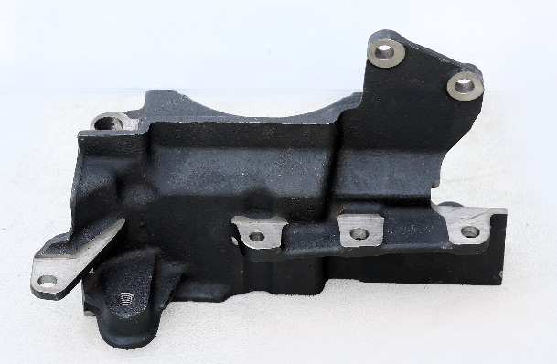
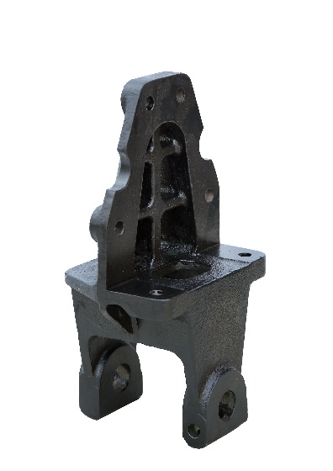
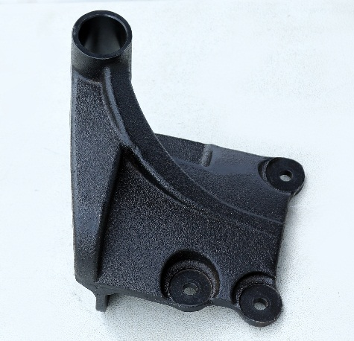
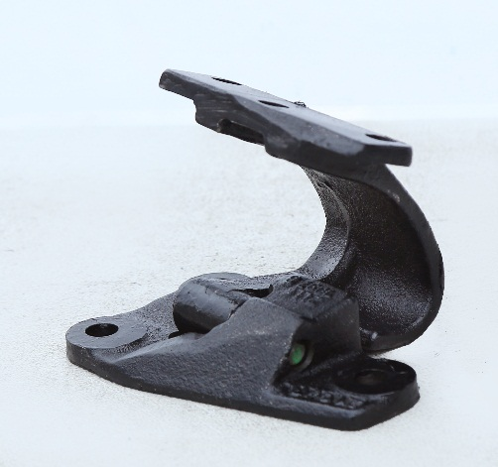
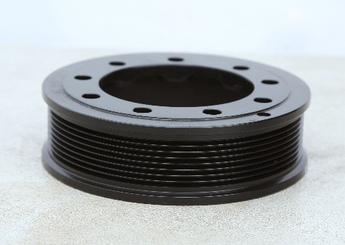
OUR PRODUCTS
SPRING BRACKET
SG IRON 10kgs
FLYWHEEL S/A
GREY IRON 40kgs
JOINT FLANGE
SG IRON 20kgs
AUX BRACKET
GREY IRON 5kgs
SPRING BRACKET
SG IRON 13kgs
MTG BRACKET
SG IRON 7kgs
POLY V PULLEY
GREY IRON 4kgs
DOOR HINGES S/A
SG IRON 2kgs

Slide 15
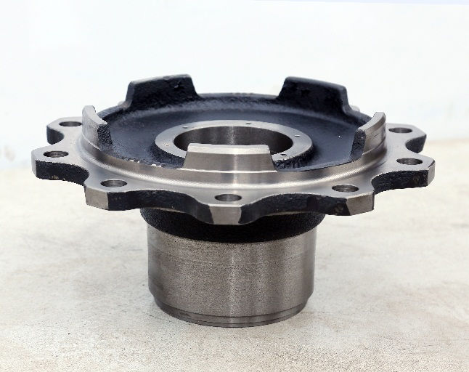
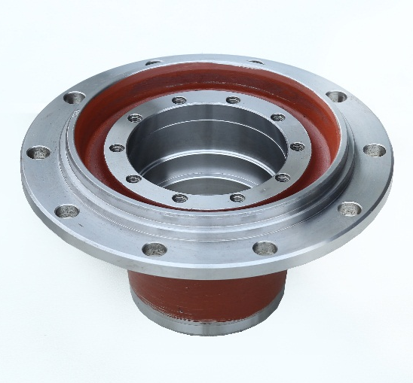
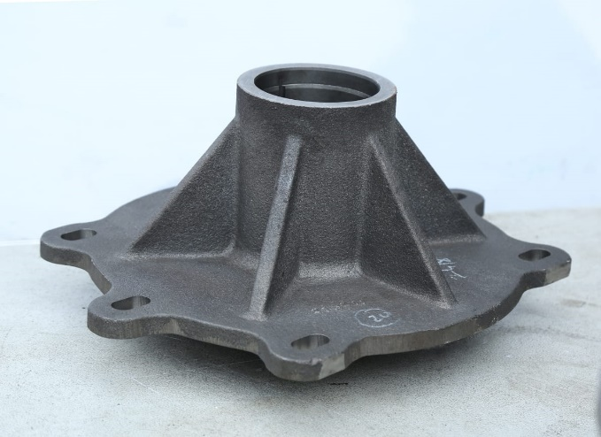
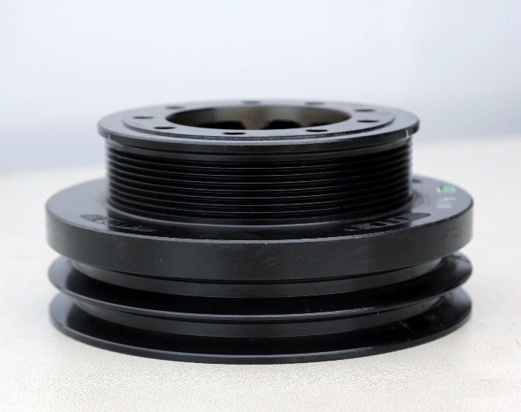
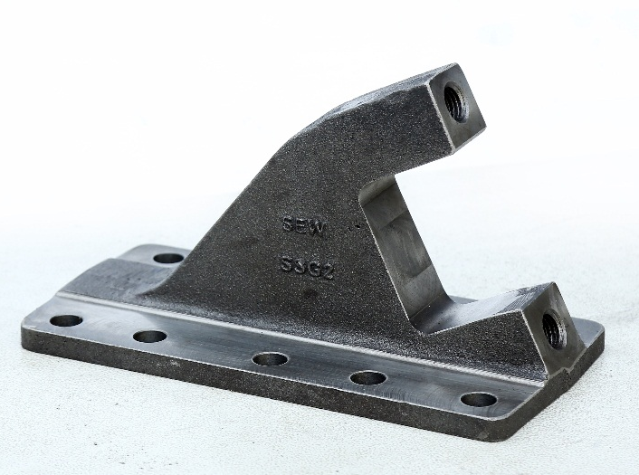

OUR PRODUCTS
HUB
SG IRON 35kgs
HUB
STEEL FORGING 45kgs
HUB
SG IRON 33kgs
PULLEY
GREY IRON 20kgs
LINK BRACKET
SG IRON 8kgs
FLYWHEEL HOUSING
GREY IRON 15kgs

Slide 16






OUR PRODUCTS
DENSO
GREY IRON 7kgs
FIP
GREY IRON 5kgs
COVER TIMER
GREY IRON 2kgs
EXHAUST ELBOW
SG IRON 2kgs
EXHAUST SECOND PIPE SG IRON 7kgs
OUTLET EXHAUST
SG IRON 3kgs

Slide 17










OUR CUSTOMERS

Slide 18
TURNOVER & FORECAST (In Millions – INR)
Covid Reason
BS6 introduction
Forecast – FY22 to FY24

Slide 19
ANNUAL TONNAGE & FORECAST - FOUNDRY
BS6 introduction
Covid Reason
Forecast – FY22 to FY24

Slide 20
CAPEX- CAPITAL INVESTMENTS PLAN (In Millions – INR)
Machine Sop | HMC – 3 Nos. with 10,000 Sq. ft. Building | HMC – 5 Nos. & VTL – 1 No. | 4 HMC with 10,000 Sq. ft. Building
Foundry | 20 million | 20 million | 20 million

Slide 21
NEW PRODUCT DEVELOPMENT PARTS – in Nos.
NPD Parts 8 Nos. per Month & 100 per annum Planned
We also have plans to design own product & Launch within 3 years
10,000 Sq ft Shed for HMCs & new lines for high volume parts
Sub-Assy lines as & wherever required

Slide 22
HR INITIATIVES
Mentorship Program for operators
FLP (Future Leaders Programme) for executives
KPI measurement system for objective performance monitor
Suggestion Scheme for improvements
Monthly performance awards based on KPI performance
Flexible timing for operators(make them owners)
Min 400 Hours of training per month

Slide 23
Improvements Plan
Improvements Per Anum
FY | T/O (in Crores) | Target % | Cost saving
FY 21-22 | 20 | 1% of T/O | 20 Lakhs
FY 22-23 | 40 | 1% of T/O | 40 Lakhs
FY 23-24 | 60 | 1% of T/O | 60 Lakhs
Improvements Plan | Target
Cycle Time reduction | Overall 1 /Day
Productivity Improvement
Cost Saving
Quality Improvement
Weight Reduction
Packing Improvement
System Improvement

Slide 24
MANPOWER WELFARE ACTIVITIES ONGOING & FUTURE PLAN
ONGOING
FUTURE PLAN
Educational assistance for employee’s children
Medical Insurance
Enhanced Food reqmts to meet global stds
Healthy Snacks offered
Daily incentives based on performances
Subsidised Food
Monthly Award function
Medical Facility
Attendance Incentives
Subsidised Hostel rent
Employee Welfare
Employee Welfare

Slide 25
FUTURE EXPANSION PLAN
Machine Shop
Diversified business Portfolio to balance market volatility. To develop 4 customers per year in different fields like pump, general Engg., machinery etc.
630mm x 630mm x 630 mm Makino make HMC – 1 No.
750 mm turning diameter CNC Vertical turret Lathe
Presetter for tool crib
In Next 3 to 4 years, we are planning to have a fully integrated Robotic machine shop with 10 machines with less or very minimum manual interference.
Online SPCs planned with digital gauges integrated to systems.
Foundry
Sarvaflex 600 Hydraulic squeeze High pressure Molding machine with box size of 980 mm x 680 mm
Spectro 9 Element Display board
Temperature Display board
Infrared non-contact pyrometer-Amitech
Vinir conveyor from knockout to shot blasting
Separate bay for Furan hand molding

Slide 26
IATF – 16949: 2016 CERTIFICATION ROAD MAP
To be accredited for IATF – 16949: 2016 by Mar-2022
IATF – 16949: 2016 CERTIFICATION ROAD MAP
Time in Months |  |  | Sep'21 | Oct'21 | Nov'21 | Dec'21 | Jan'22 | Feb'22 | Mar'22 | Apr,22 | May’22 | Jun’22 | Jul’22
Activity | Responsibility
Preparation of Quality Manual, Turtle Diagrams, Procedures and Supplier Manual as per IATF requirements | IATF Consultant |  | Completed
Internal auditing as per IATF 16949 | MR, Core team & consultant |  |  | Completed
Closing all gaps/NCs/improvements | Core team - SREW |  |  |  |  |  |  |  |  |  |  | Under Progress
Stage 1 audit | CB & SREW |  |  |  |  |  |  |  |  |  | Completed
Stage 2 audit | CB & SREW |  |  |  |  |  |  |  |  |  |  |  | Planned
ISO 14001 – 2015 EMS CERTIFICATION ROAD MAP
To be accredited for ISO 14001 – 2015 EMS planned before Mar - 2023
ISO 14001 – 2015 EMS CERTIFICATION ROAD MAP
Time in Months |  | Sep'22 | Oct'22 | Nov'22 | Dec'22 | Jan'23 | Feb'23 | Mar'23
Activity |  | Status | Status | Status | Status | Status | Status | Status
EMS Manual Preparation |  | Plan
Internal Audit NC closing & MRM |  |  | Plan | Plan
Documentation Audit |  |  |  |  | Plan
Certification Audit |  |  |  |  |  | Plan
EMS Certificate |  |  |  |  |  |  |  | Planned

Slide 27


CUSTOMER AWARDS

Slide 28


Slide 29

THANK YOU

